Slide 1
INSTRUCTIONS

Slide 2
instructions
Instructions spell out the steps required for completing a task or a series of tasks (say, installing printer software on your computer or operating an electron microscope).
The audience for a set of instructions might be someone who doesn't know how to perform the task or someone who wants to perform it more effectively. In either case, effective instructions enable people to complete a job safely and efficiently.

Slide 3
PROCEDURES
Procedures, a special type of instructions, serve also as official guidelines.
Procedures ensure that all members of a group (such as employees at the same
company) follow the same steps to perform a particular task. For example, many companies have procedures in place that must be followed for evacuating a building or responding to emergencies.

Slide 4
Considering Audience and purpose
Before preparing instructions, find out how much your audience already
knows about the task(s) involved.
The general purpose of instructions is to help people perform a task. The
task may be simple (inserting a new toner cartridge in a printer) or complex
(using an electron microscope).
Whatever maybe the task, people will have some basic
questions:
• Why am I doing this?
• How do I do it?
• What materials and equipment will I need?
• Where do I begin?
• What do I do next?
• What could go wrong?

Slide 5
FORMATS FOR INSTRUCTIONAL DOCUMENTS
Instructional documents take various formats. Here are some of the most
commonly used:
Manuals contain instructions for all sorts of tasks. A manual also may contain descriptions and specifications for the product, warnings, maintenance and troubleshooting advice, and any other information the reader is likely to need.

Slide 6
REFERENCE CARDS
Brief reference cards typically fit on a single page or less. The instructions usually focus on the basic steps for people who want only enough information to start on a task and to keep moving through it.

Slide 7
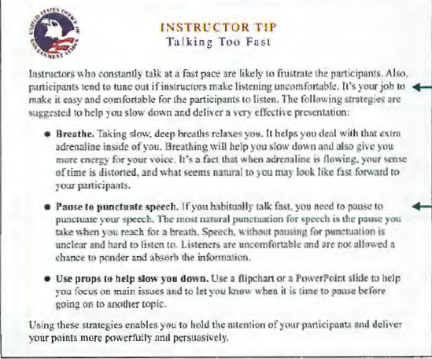

Slide 8
INSTRUCTIONAL BROCHURES
Instructional brochures can be displayed, handed out, mailed, or otherwise distributed to a broad audience. They are especially useful for advocating procedures that increase health and safety.

Slide 9
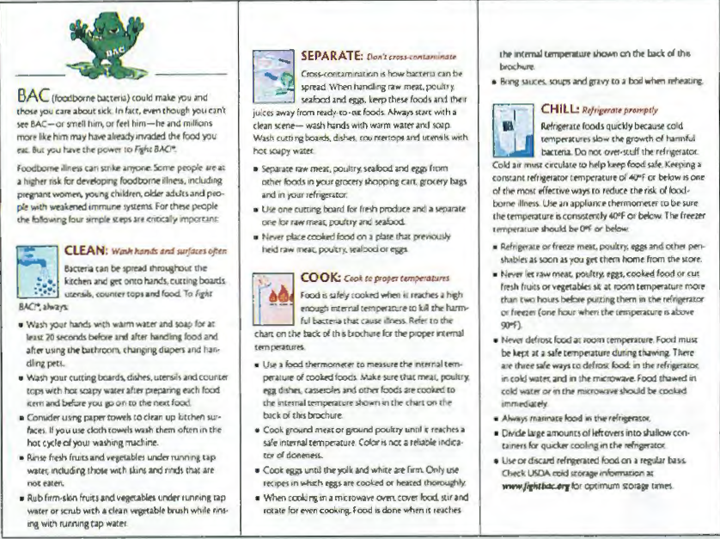

Slide 10
HYPERLINKED INSTRUCTIONS
Hyperlinked instructions enable people to explore various levels and layers of information and to choose the layers that match their needs.

Slide 11

Links
provide
quick access
to other
information
Numbered
steps are
easy to see

Slide 12
ONLINE INSTRUCTIONS
Online instructions provide the contents of a hard-copy manual as a link on a Website. Whereas people with less experience tend to prefer paper documentation, online help is especially popular among people with more experience.

Slide 13
ELEMENTS OF EFFECTIVE INSTRUCTIONS
Clear and Limiting Title
Provide a clear and exact preview of the task. For example, the title " Instructions for Cleaning the Drive Head of a Laptop Computer" tells people what to expect: instructions for a specific procedure involving one selected part. But the title "The Laptop Computer" gives no such forecast; a document so titled might contain a history of the laptop, a description of each part, or a wide range of related information.

Slide 14
Informed Content
Make sure that you know exactly what you are talking about. Ignorance, inexperience, or misinformation on your part makes you no less liable for faulty or inaccurate instructions:
Unless you have performed the task often, do not try to write instructions for
other people confronting this task.

Slide 15
Visuals
Instructions often include a persuasive dimension: to promote interest, commitment, or action. In addition to showing what to do, visuals attract the reader's attention and help keep words to a minimum.
Types of visuals especially suited to instructions include icons, representational and schematic diagrams, flowcharts, photographs, and prose tables.

Slide 16
To use visuals effectively, consider these suggestions:
• Illustrate any step that might be hard for readers to visualize. The less specialized your readers, the more visuals they are likely to need.
• Avoid illustrating any action simple enough for readers to visualize on their
own, such as "PRESS RETURN" for anyone familiar with a keyboard.

Slide 17
Visuals can be used without words, too, especially for international audiences.
Often called wordless instructions, these diagrams use clear, simple line drawings,
arrows, and call-outs lo let people see how to do something

Slide 18
Appropriate Level of Detail and Technicality
Unless you know your readers have the relevant background and skills, write for a general audience, and do three things:
I. Give readers enough background to understand why they need to follow these
instructions.
2. Give enough detail lo show wlwt to do.
3. Give enough examples so each step can be visualized clearly.

Slide 19
INSTRUCTIONS
Use Direct Address, Active Voice, and Imperative Mood
Write instructions in the second person, as direct address, in order to emphasize the role of the reader.
In general, begin all steps and sub steps with action verbs, using the active voice and imperative mood ("Insert the disk" instead of "The disk should be inserted" or "You should insert the disk").
The opening verb should announce the specific action required.
Use Short and Logically Shaped Sentences

Slide 20
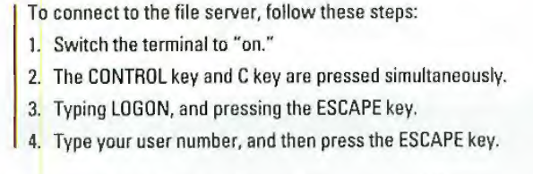
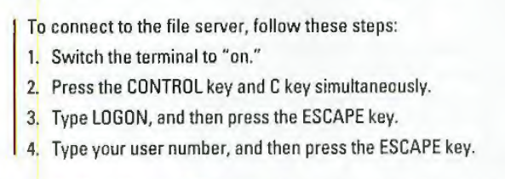

Slide 21

Phrase Instructions Affirmatively. Research shows that people respond more
quickly and efficiently to instructions phrased affirmatively rather than negatively

Slide 22
Tips to write instructions
Provide all the necessary information.
Don't provide unnecessary information
Instead of focusing on the product, focus on the task. "How does it work?“
"How do I use it?" or "How do I do it?“
Omit steps that are obvious.
Divide the task into simple steps and substeps.
Reinforce the prose with visuals.
Keep it simple.
Recognize the persuasive dimension of the instructions. Readers may need
persuading that this procedure is necessary or beneficial, or that they can complete this procedure with relative ease and competence.
Readability: Instructions must be understood on the first reading because people want to takeimmediate action.

